Slide 1
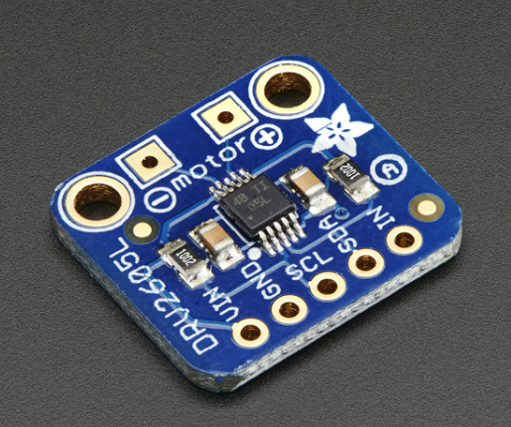
DRV2605 Haptic Motor Driver
Jordan Pulido

Slide 2
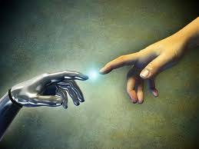
Introduction (Proposal)
In virtual reality, when an object rubs or passes through a surface, the user is restricted to feeling the realism (texture, and friction) throughout the experience.
When a surface is being in contact with a certain object or tool, these objects can be determined by the roughness, hardness, or slipperiness.
To capture these characteristics, a haptic driver will read the different functions, which the model is used to produce vibration signals and generate force.

Slide 3
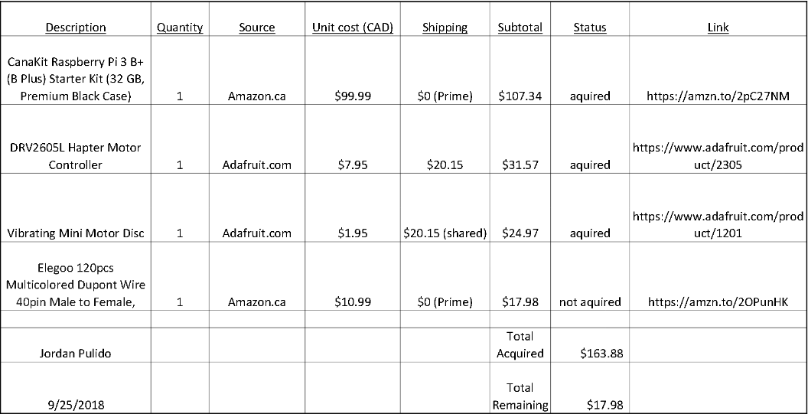
budget

Slide 4
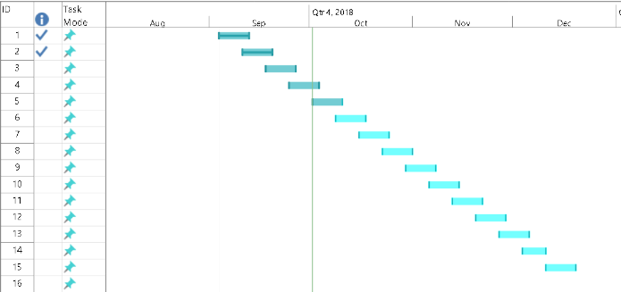
Schedule

Slide 5
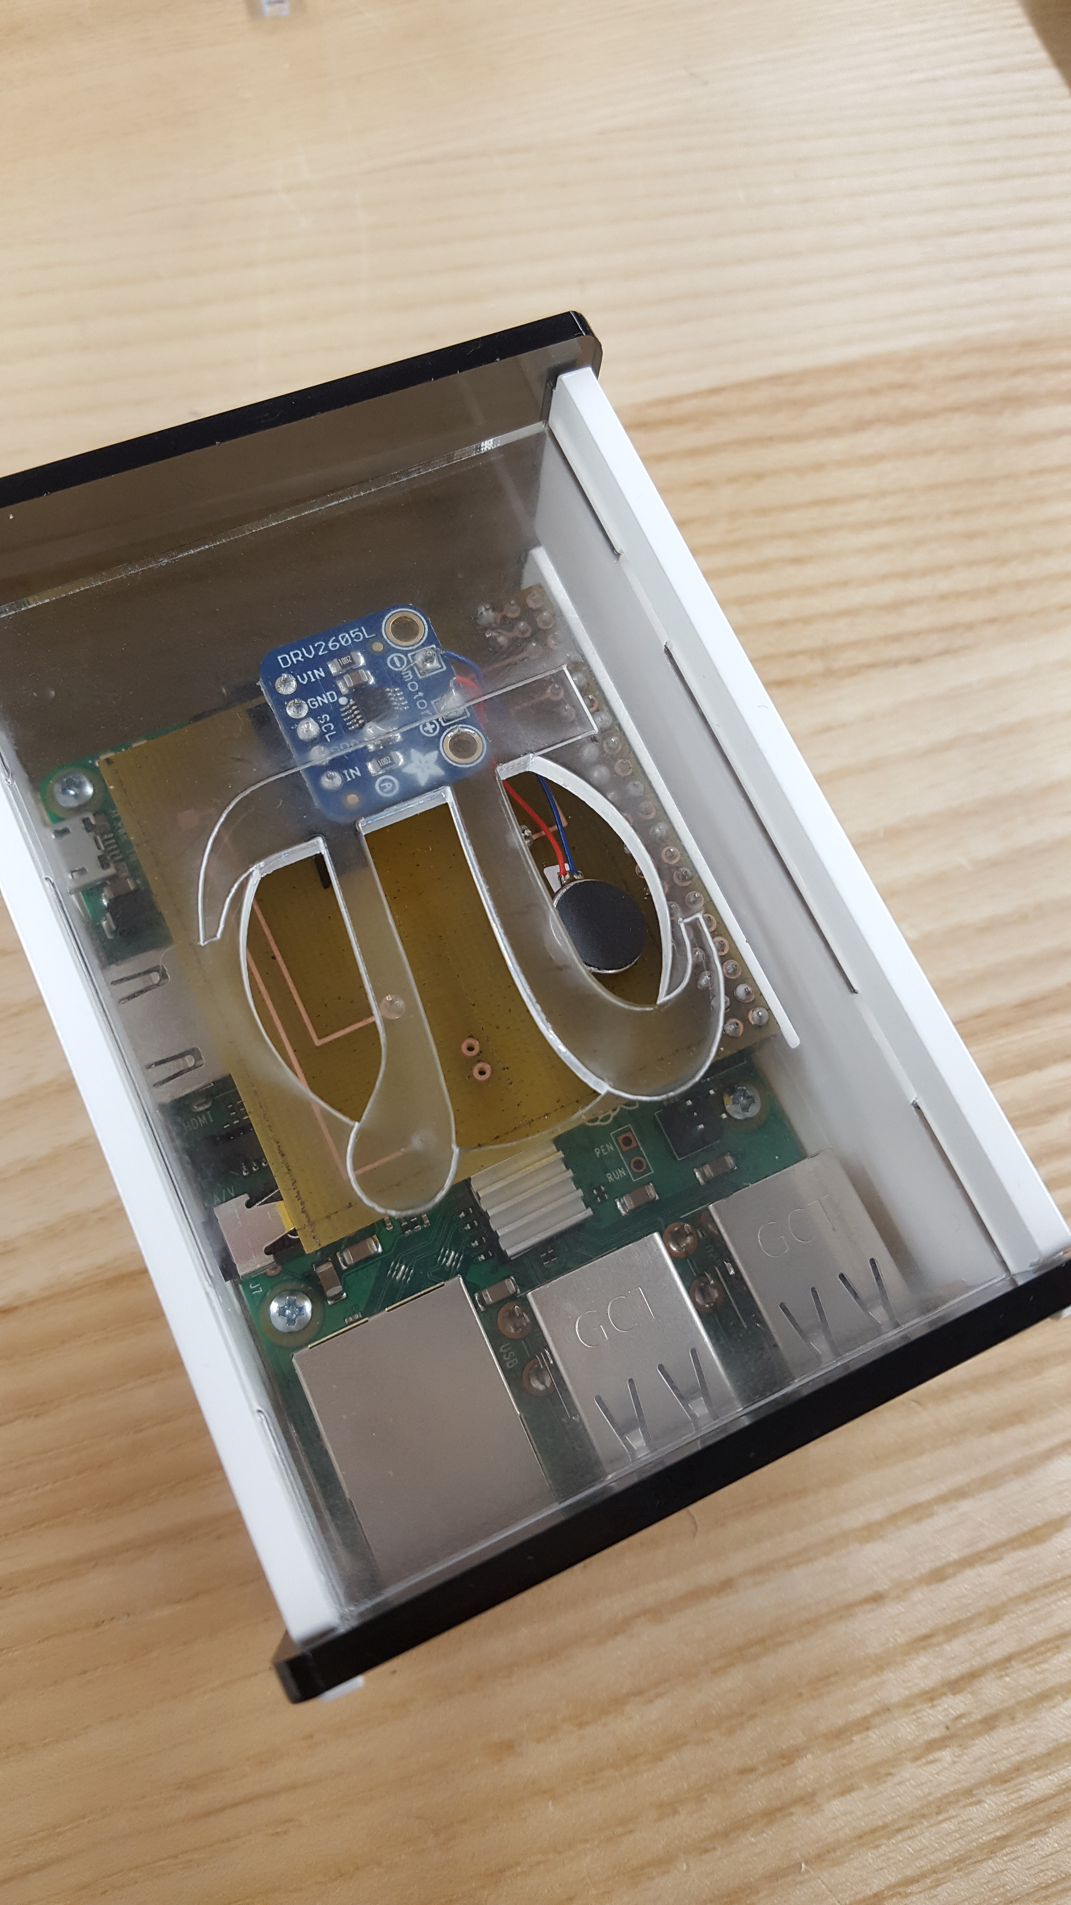
Enclosed Hardware

Slide 6
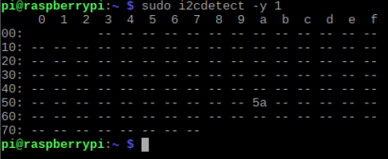
Address
DRV2605 Haptic Motor Driver (0x5A)

Slide 7
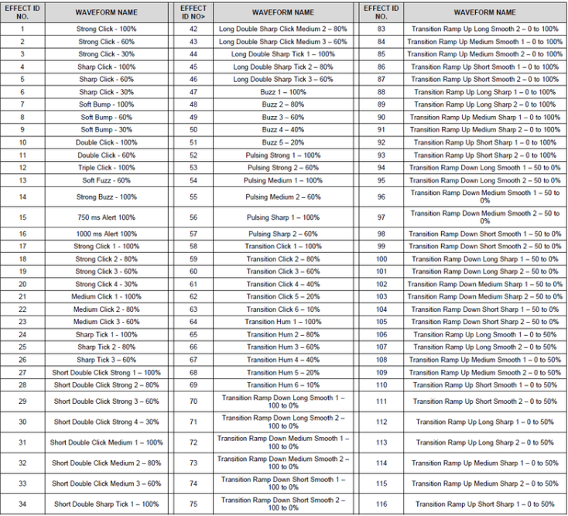
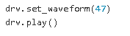
Reading
https://cdn-shop.adafruit.com/datasheets/DRV2605.pdf

Slide 8
Previous course knowledge
CENG 216 – Introduction to Software Engineering
CENG 252 – Embedded Systems
CENG 200 – Unix Scripting

